Slide 1
Pakistan – My Country
Zainab Sajjad

Slide 2
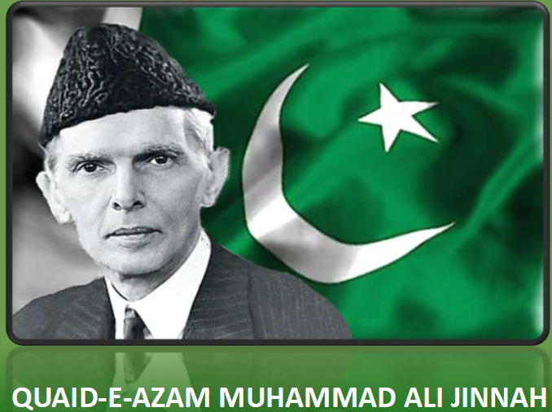
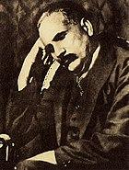
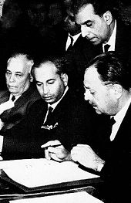
Creation of Pakistan
Officially the Islamic Republic of Pakistan
Pakistan gained independence in 1947 after the Partition of the British Indian Empire
Founder: Muhammad Ali Jinnah
Concept of Pakistan: Allama Muhammad Iqbal
Constitution: 1973
Atomic Power: 1998

Slide 3

Pakistan Documentary in 6min
A introductory 6 minute movie

Slide 4

Some Facts
World's fifth-most populous country,
With a population exceeding 225.2 million,
World's second-largest Muslim population,
33rd-largest country by area,
Area: 881,913 km2
Population 2021 estimate 225,199,937 (5th)
Currency Pakistani rupee (₨) (PKR)
Time zone UTC+05:00 (PST)
National Anthem in the vidéo
National Anthem by Coke Studio

Slide 5
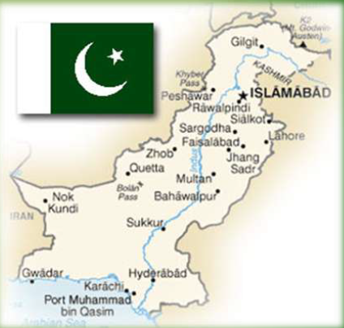
Geographical Position
Is a country in South Asia
It has a 1,046-kilometre (650-mile) coastline along the Arabian Sea and
Gulf of Oman in the south,
and is bordered by India to the east,
Afghanistan to the west,
Iran to the southwest,
and China to the northeast.
It is separated narrowly from Tajikistan by Afghanistan's Wakhan Corridor in the north,
and also shares a maritime border with Oman.

Slide 6
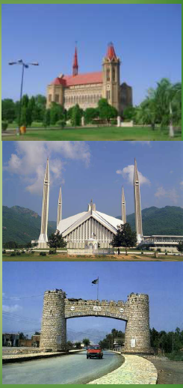
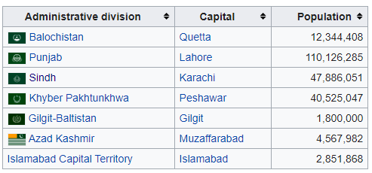
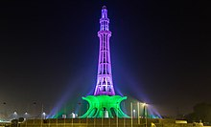
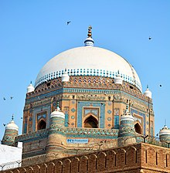
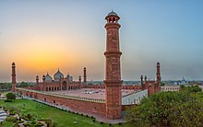
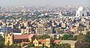
Provinces and Important Cities
Provinces
Sindh
Khyber Pakhtun khawah
Baluchistan
Punjab
Capital Islamabad
Largest city Karachi
Quetta
Lahore
Peshawar

Slide 7
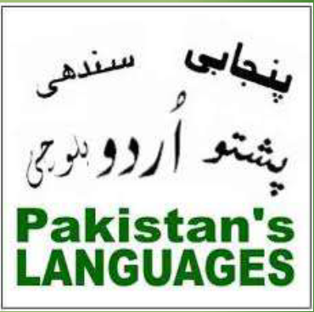
Regional Languages
Punjabi (39%)
Pashto (18%)
Sindhi (15%)
Saraiki (12%)
Balochi (3%)
Hindko (2%)
Pothwari (1%)
Brahui (1%)
Kashmiri (0.17%)

Slide 8
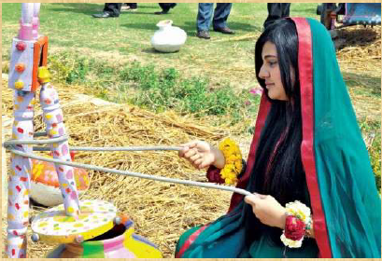
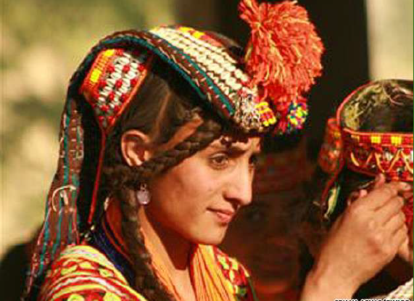
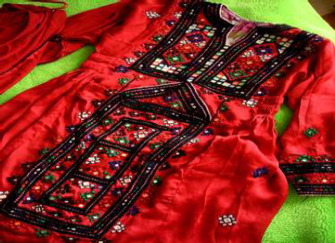

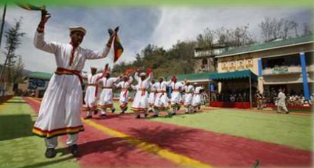
Ethnic Groups
44.7% Punjabis
15.4% Pashtuns
14.1% Sindhis
8.4% Saraikis
7.6% Muhajirs
3.6% Balochs
6.3% Others

Slide 9
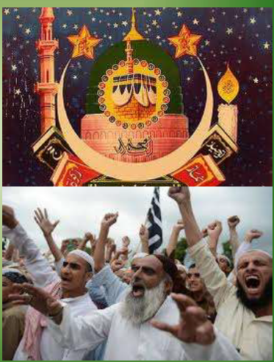
Religion
96.47% Islam
2.14% Hinduism
1.27% Christianity
0.9% Ahmadiyya
0.02% Others
Azan in Faisal Mosque Islamabad
Azan in Faisal Mosque

Slide 10
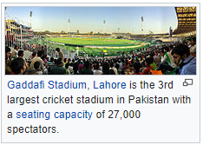
Sports
National game: Hockey
Won World Cup: 1971, 1978, 1982, and 1994
Olympics: 1960, 1968, and 1984
Most Popular game: Cricket
Won cricket world cup: 1992
T20 International World Cup: 2009
World Fastest Bowler: Shoaib Akhtar

Slide 11
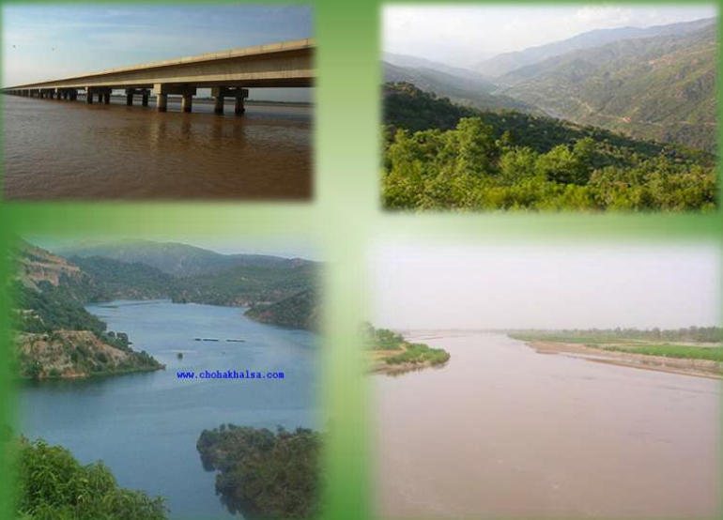

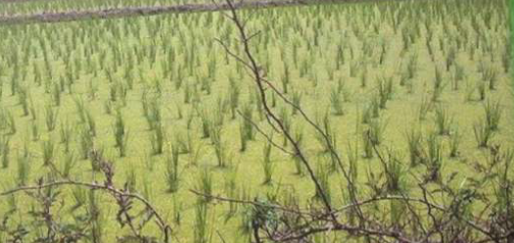
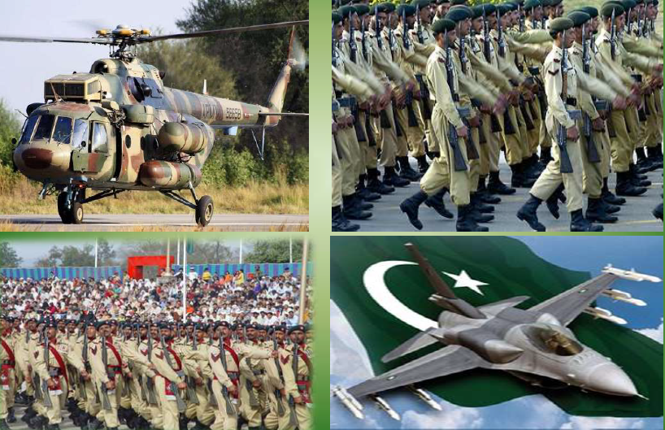
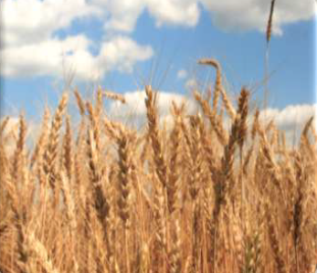
Further Facts
Pakistan has four seasons
World 5th largest gold mine
World 7th largest copper mine
World 7th Nuclear Power
Five Rivers (Sindh, Jehlam, Ravi, Satluj, Chanab)
World 6th largest army
7th largest rice producer
8th largest rice producer

Slide 12
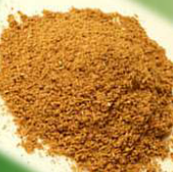
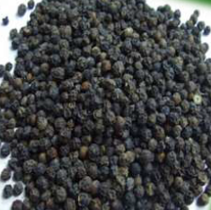
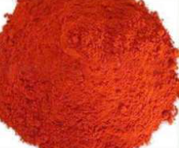
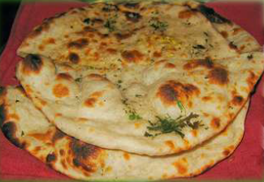
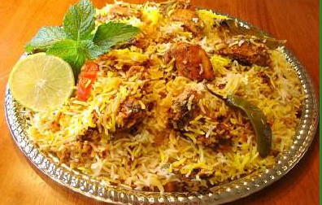
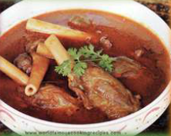

Pakistani Food
Partly Influenced by Arab, Persian and Indian Cuisine, it retains its own distinct Pakistani flavour
Pakistani dishes are known for having spicy flavours
Pakistani focus on other area of food such as beef, lamb, chicken, fish, lentils and vegetables as well as traditional fruit and dairy products.

